Slide 1
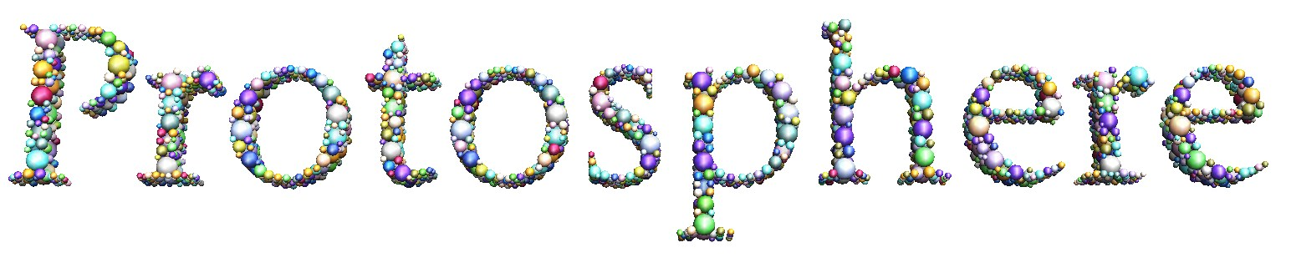
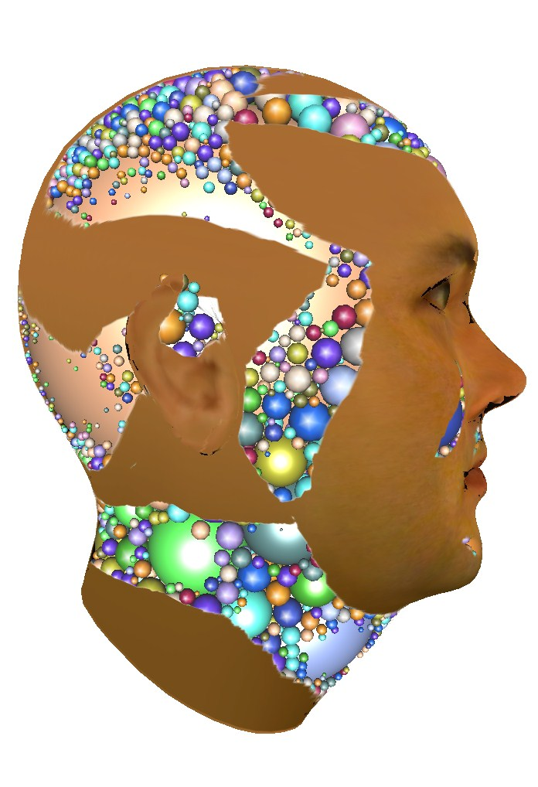
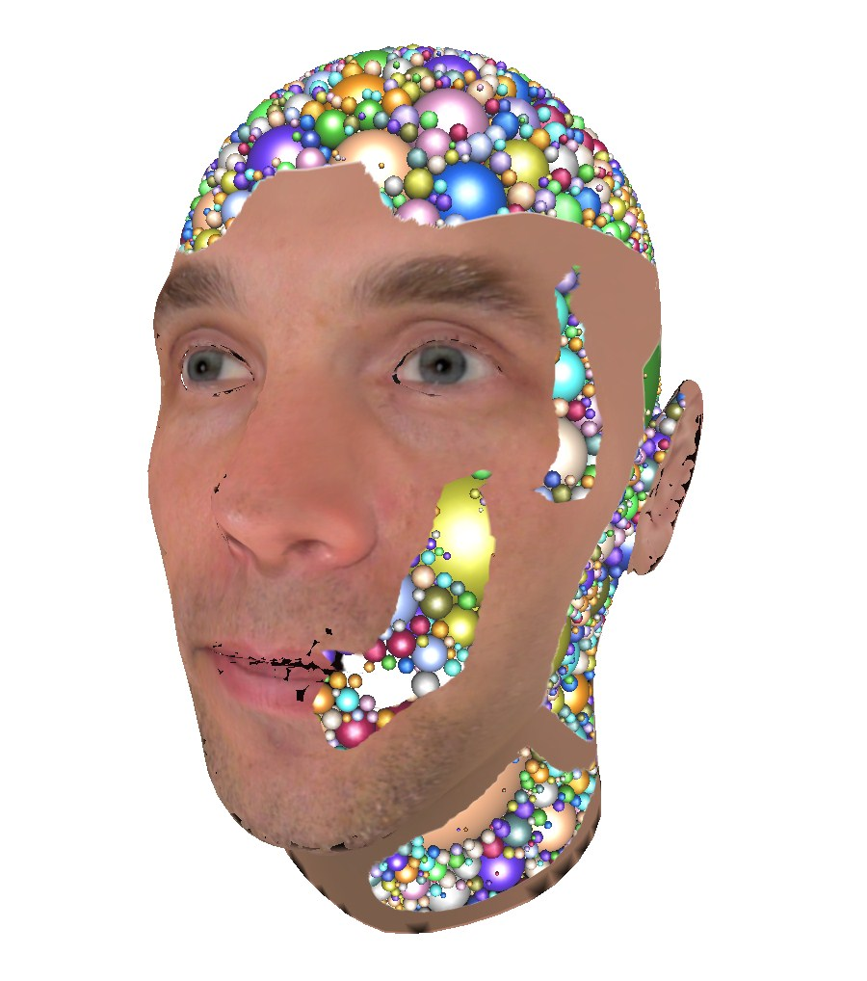
A GPU-Assisted Prototype Guided
Sphere Packing Algorithm for Arbitrary Objects
René Weller and Gabriel Zachmann
Clausthal University, Germany
{weller,zach}@in.tu-clausthal.de
Siggraph Asia ’10, Dec 2010, Seoul, South Korea
Motivation Basic Algorithm Parallel Algorithm Results Conclusion

Slide 2
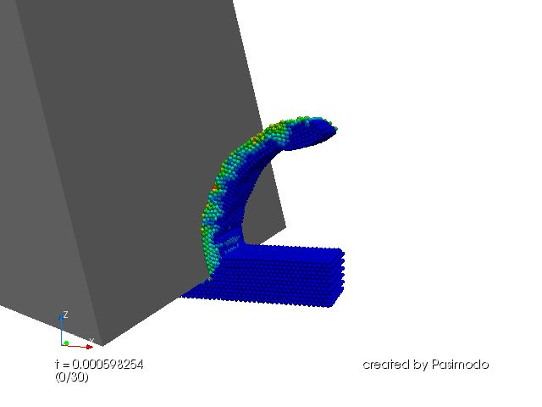
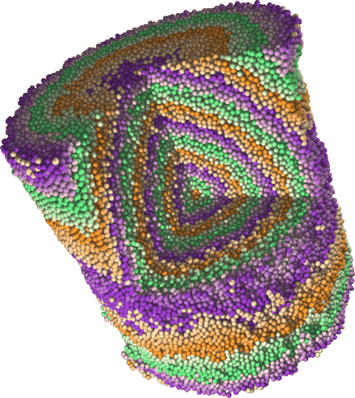
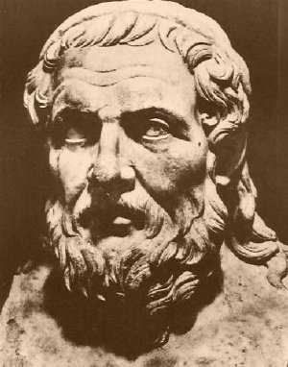
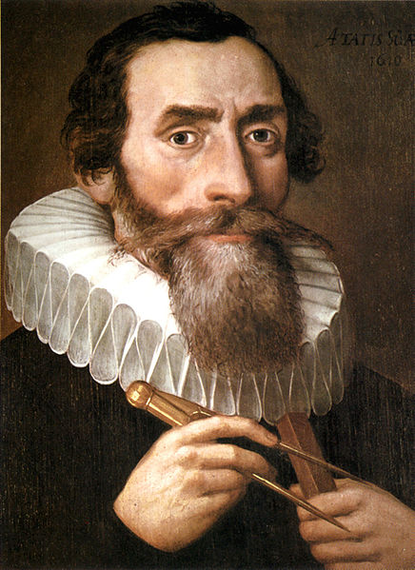
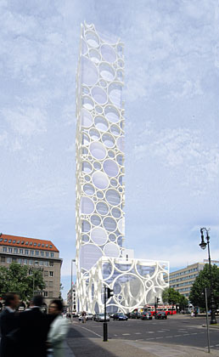
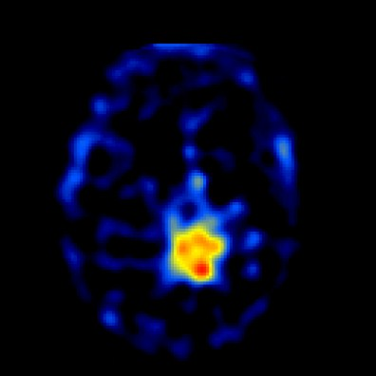
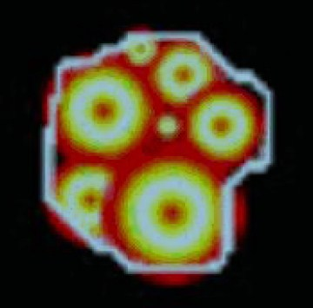
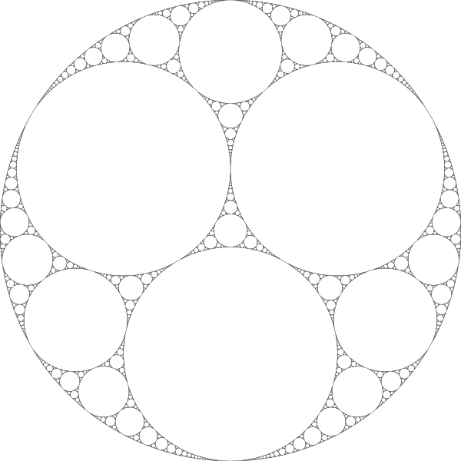
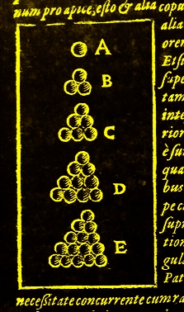
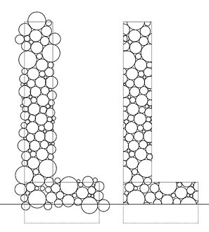
Motivation
P. Eberhard et al, 2009
T. Aste and D. Weaire, 2008
Apollonius of Perga (262–190 BC)
Johannes Kepler (1571 – 1630)
Apollonian gasket
Kepler conjecture
Long Yun et al, 2002
smo architektur, 2006
Motivation Basic Algorithm Parallel Algorithm Results Conclusion

Slide 3

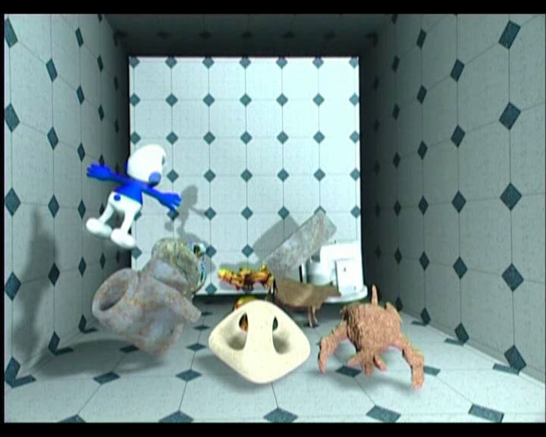
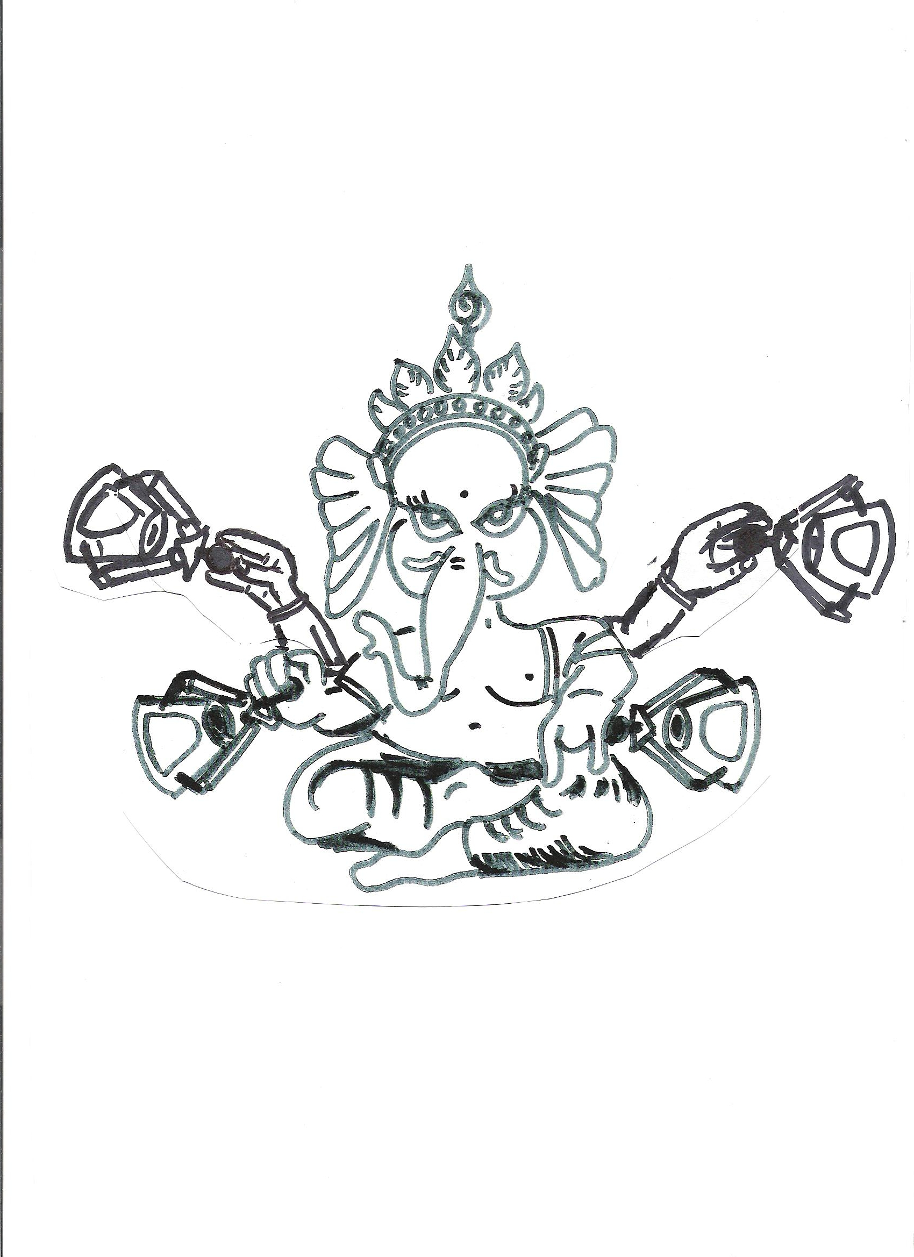
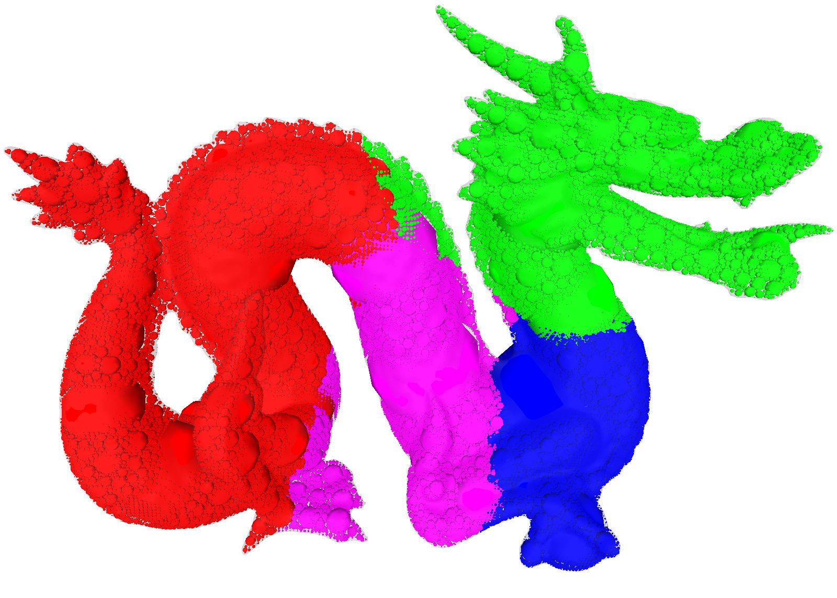
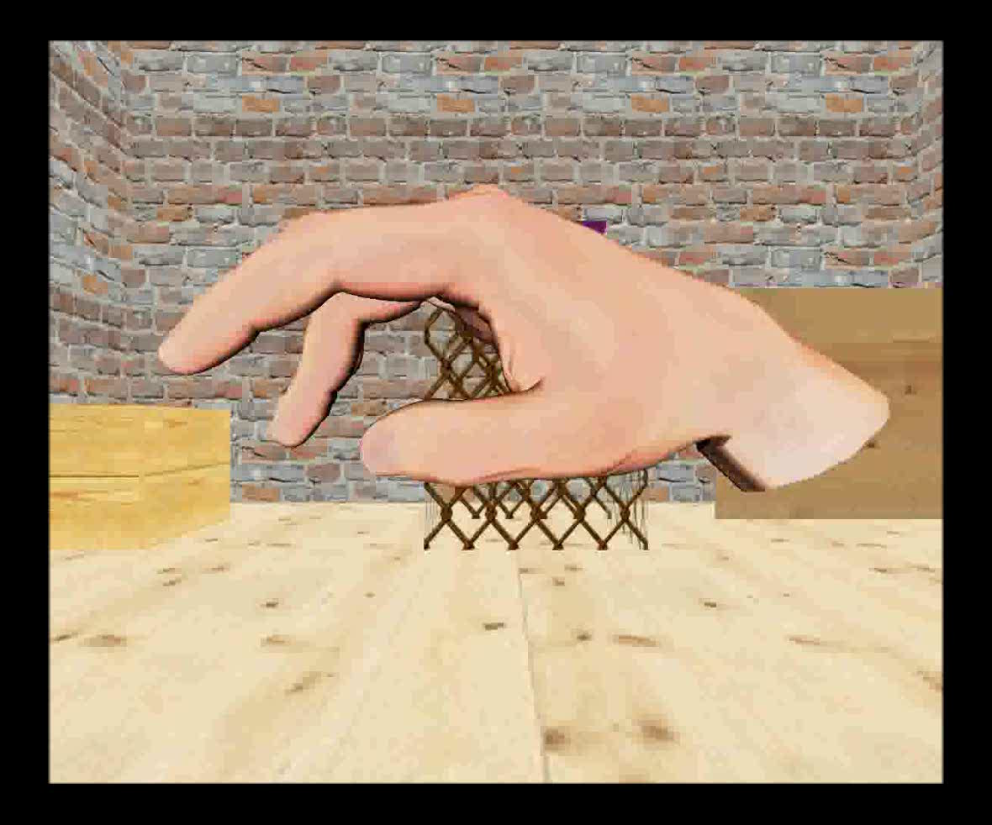
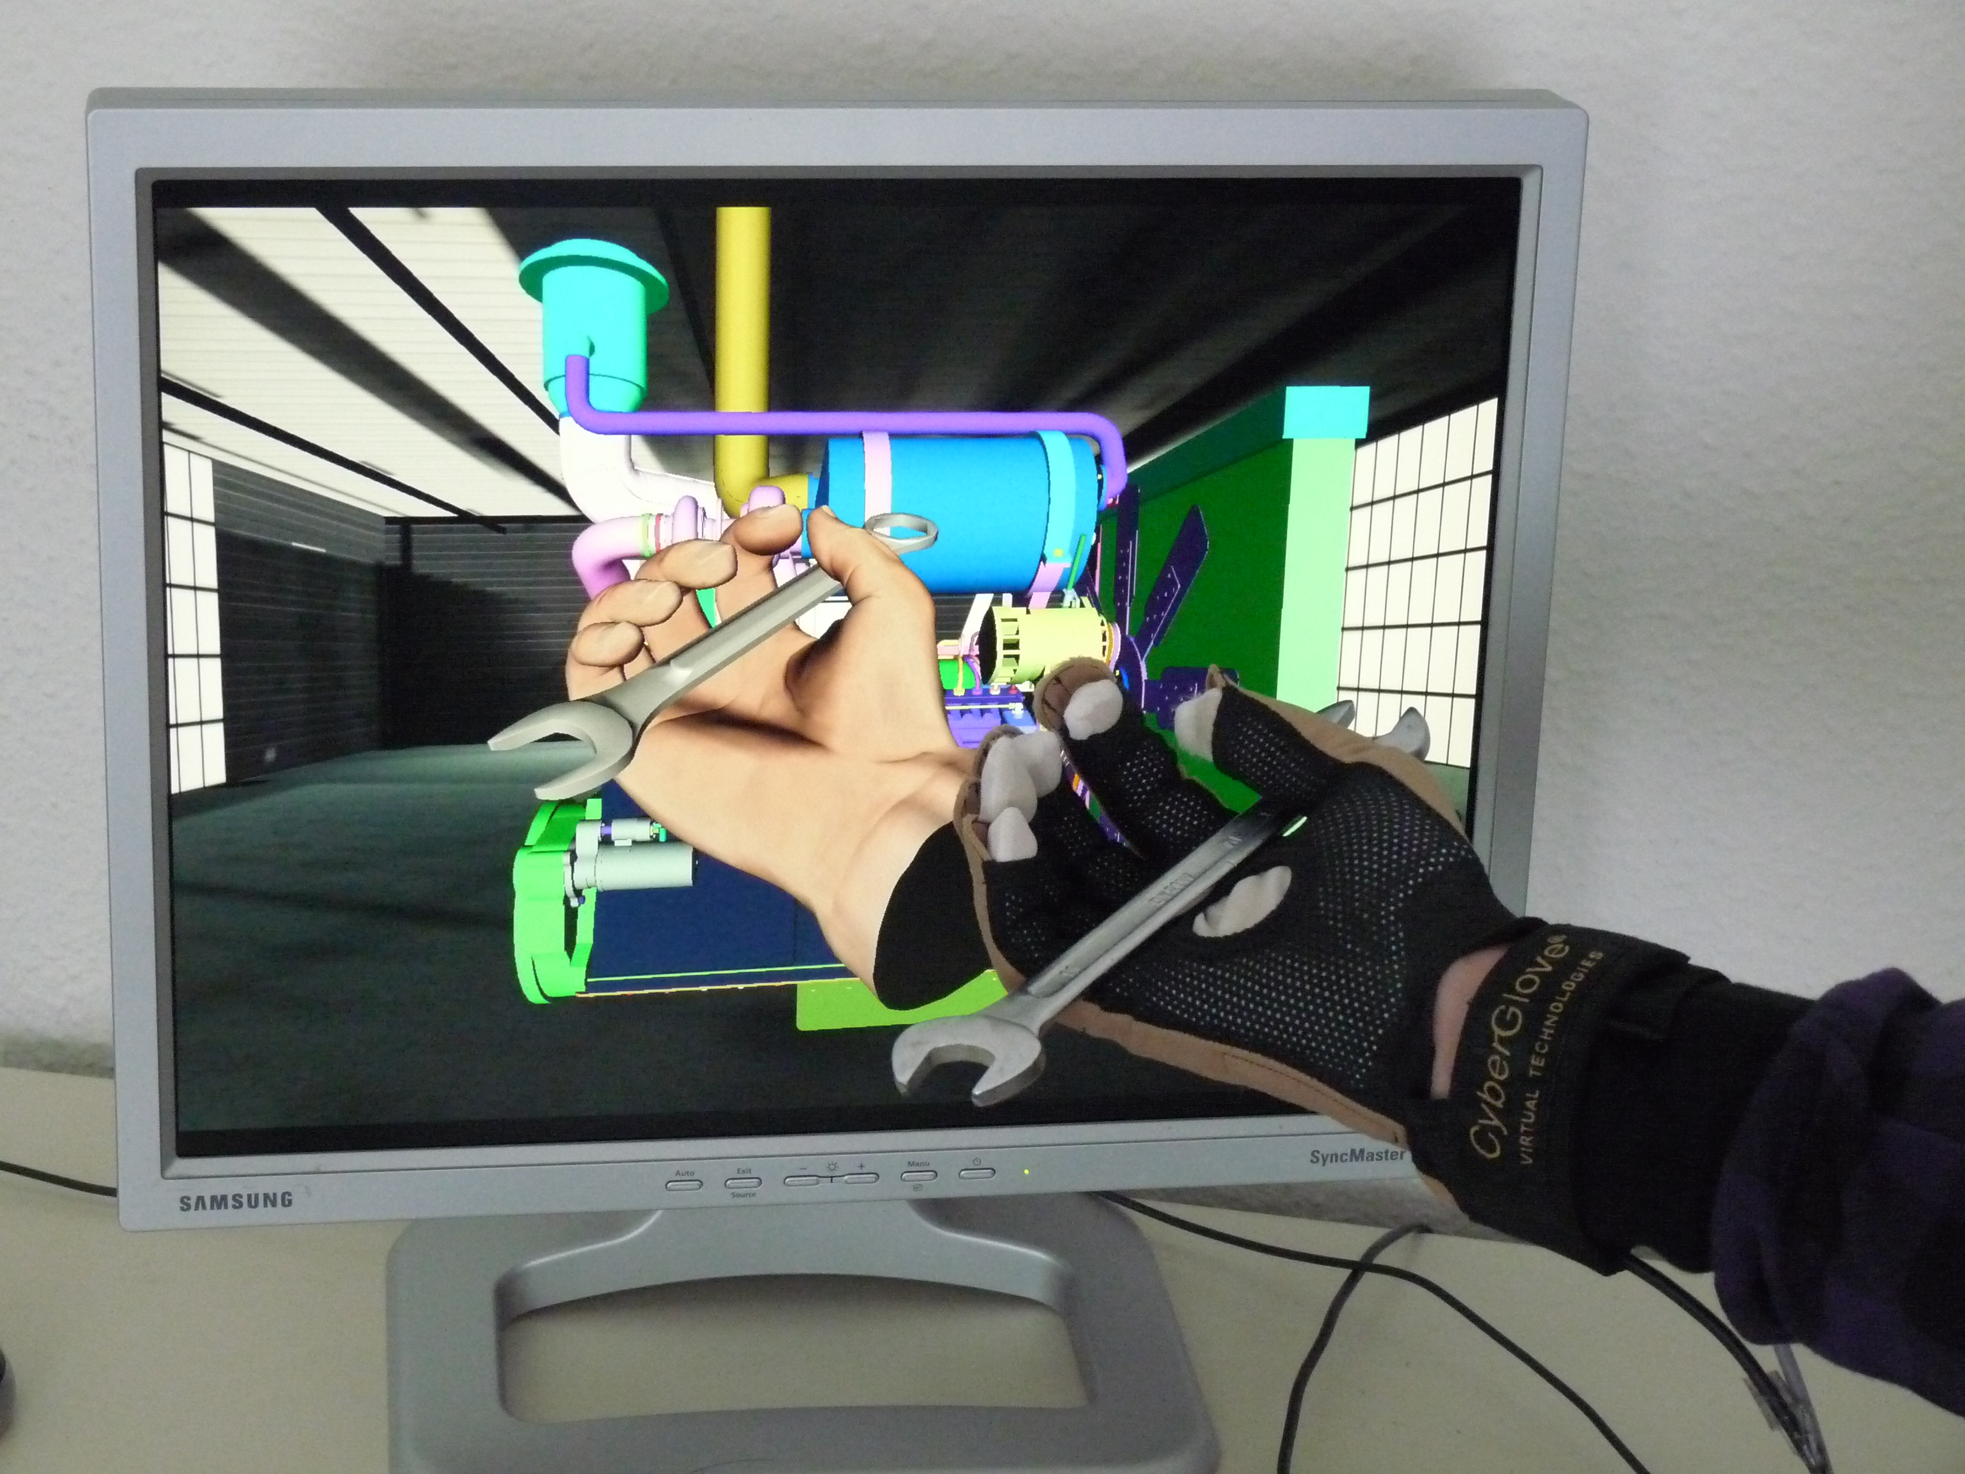
Our Applications
Haptesha
Motivation Basic Algorithm Parallel Algorithm Results Conclusion

Slide 4
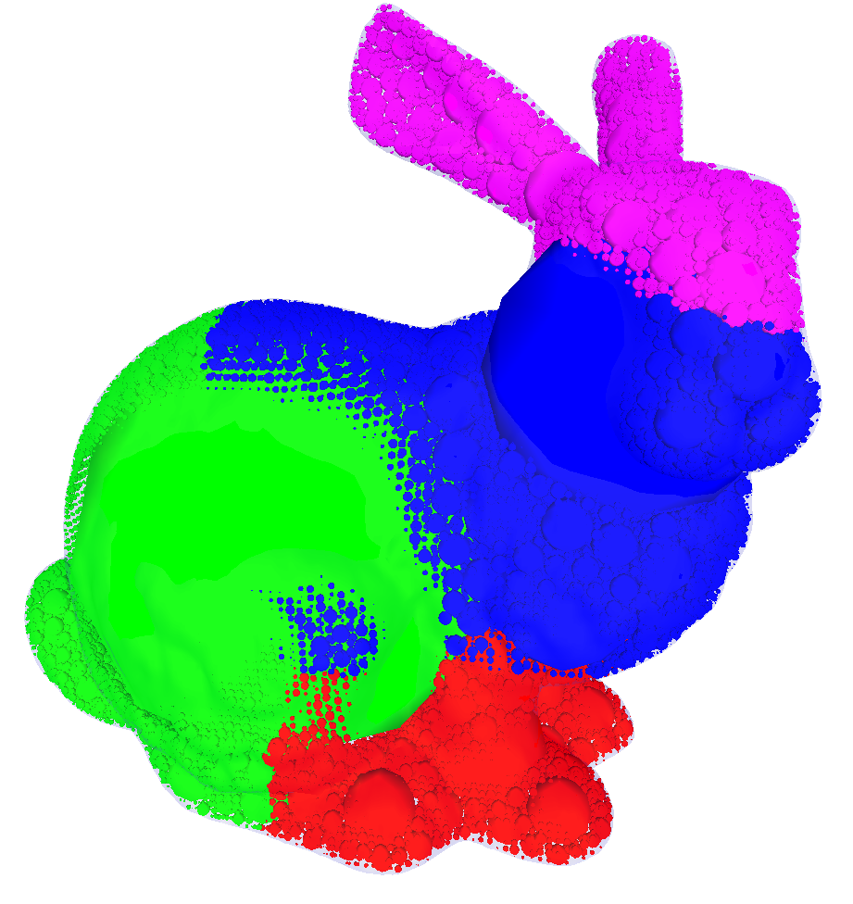
Requirements
Spheres must not overlap
Spheres should fill the objects densly
  User definable balance between accuracy and speed
Fast
Stable
Should work for all object representations
  Polygonal meshes
  Nurbs surfaces
  CSG
  Point clouds
  …
Motivation Basic Algorithm Parallel Algorithm Results Conclusion

Slide 5
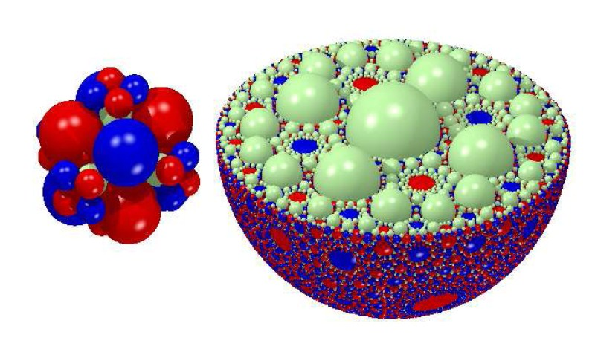
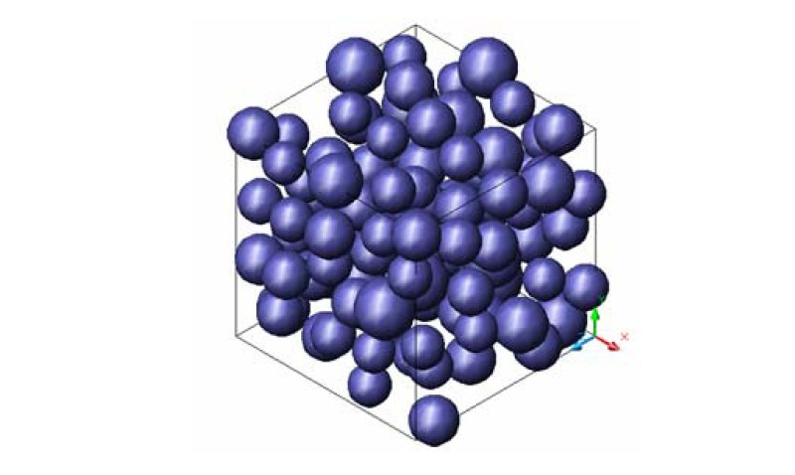
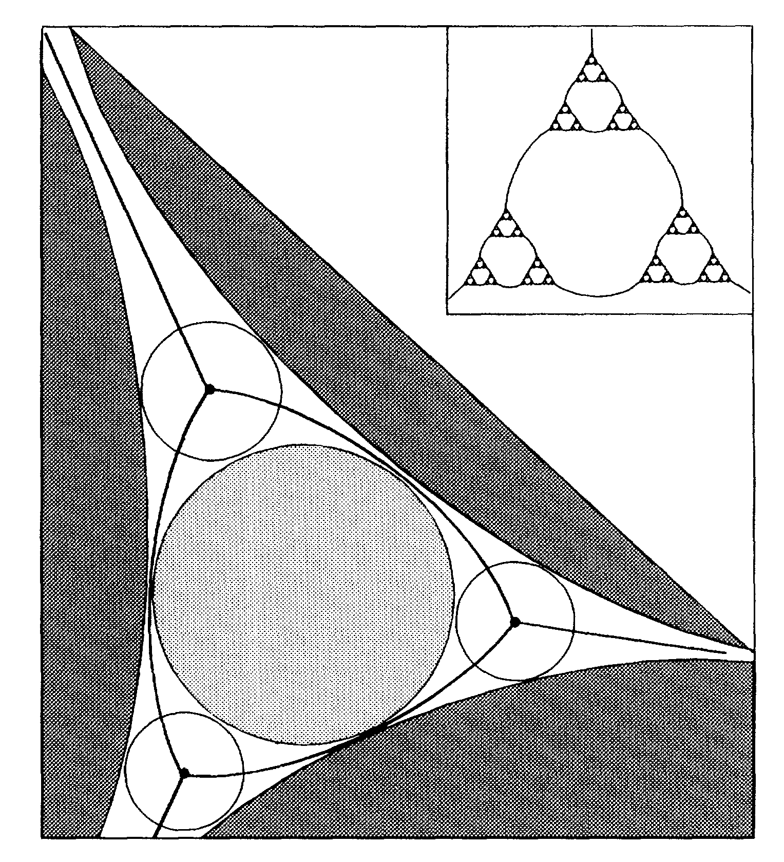
Previous Works
Monte Carlo study of the sphere packing problem
  S.P. Lia and Ka-Lok Ng, 2003
Dense packings
  H. J. Herrmann, R. Mahmoodi Baram and M. Wackenhut, 2006
Fractal Properties of Dense Packing of Spherical Particles
  Adil Amirjanov and Konstantin Sobolev, 2006
Three-Dimensional Apollonian Packing as a Model for Dense Granular Systems
  V. Anishchik und N. N. Medvedev, 1995

Slide 6
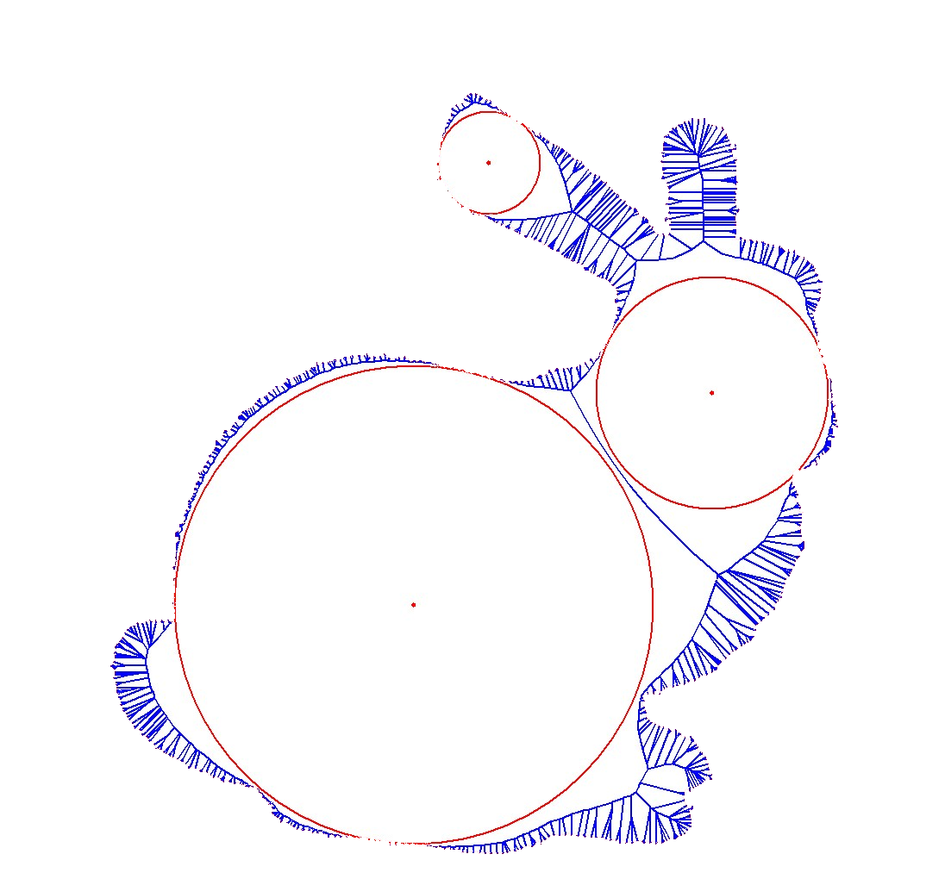
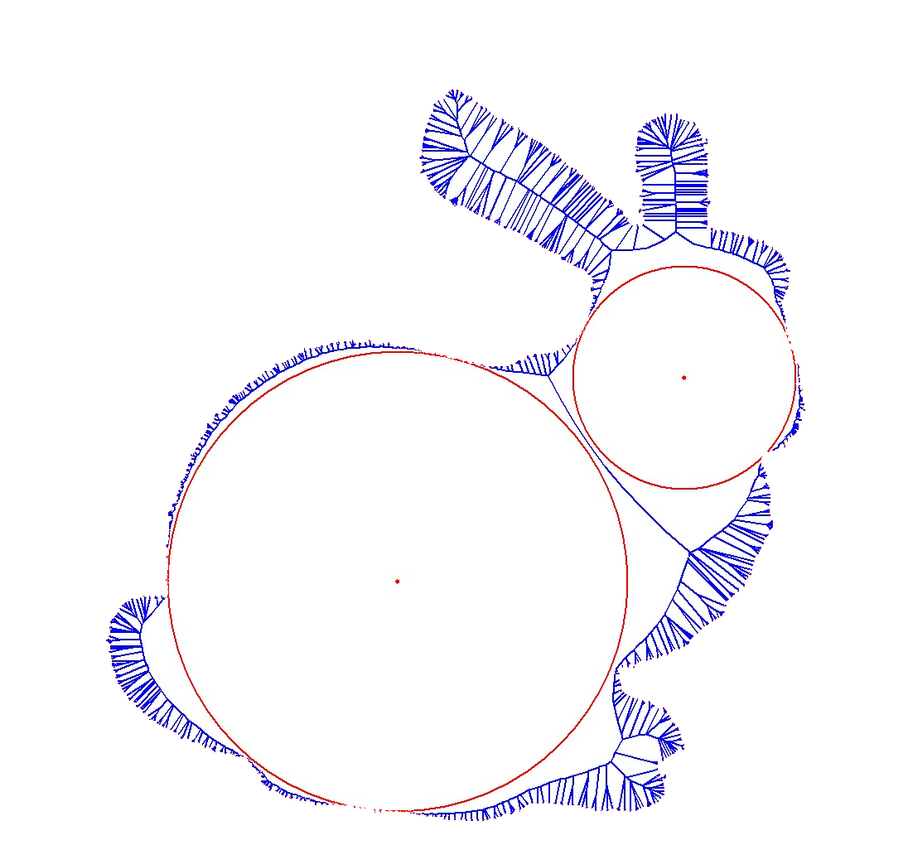
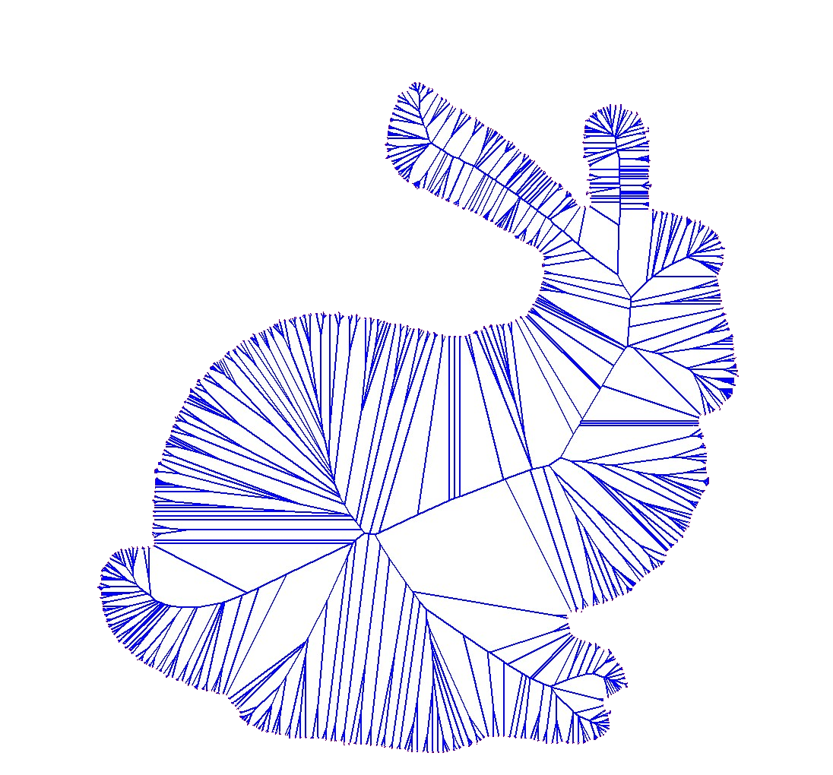
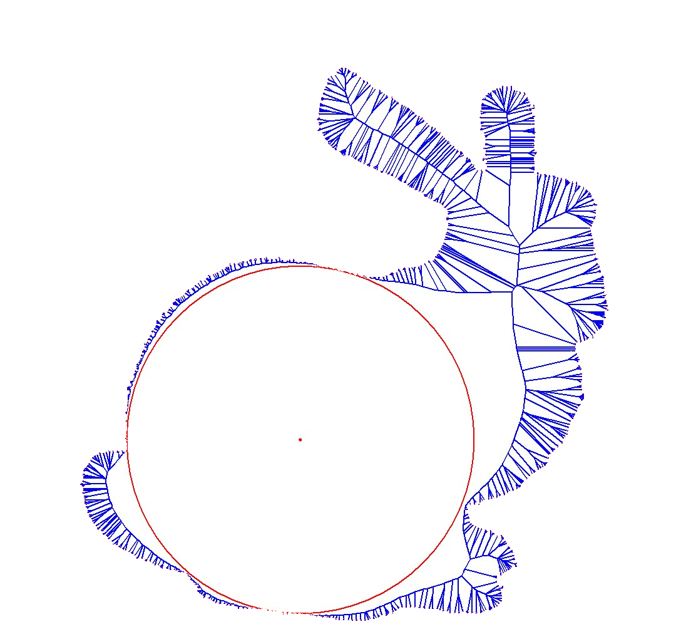
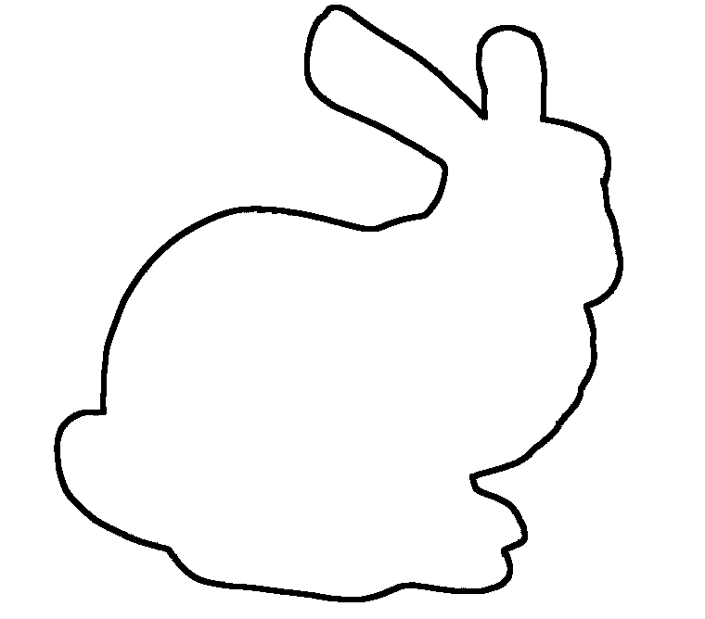
Basic Idea
Motivation Basic Algorithm Parallel Algorithm Results Conclusion

Slide 7
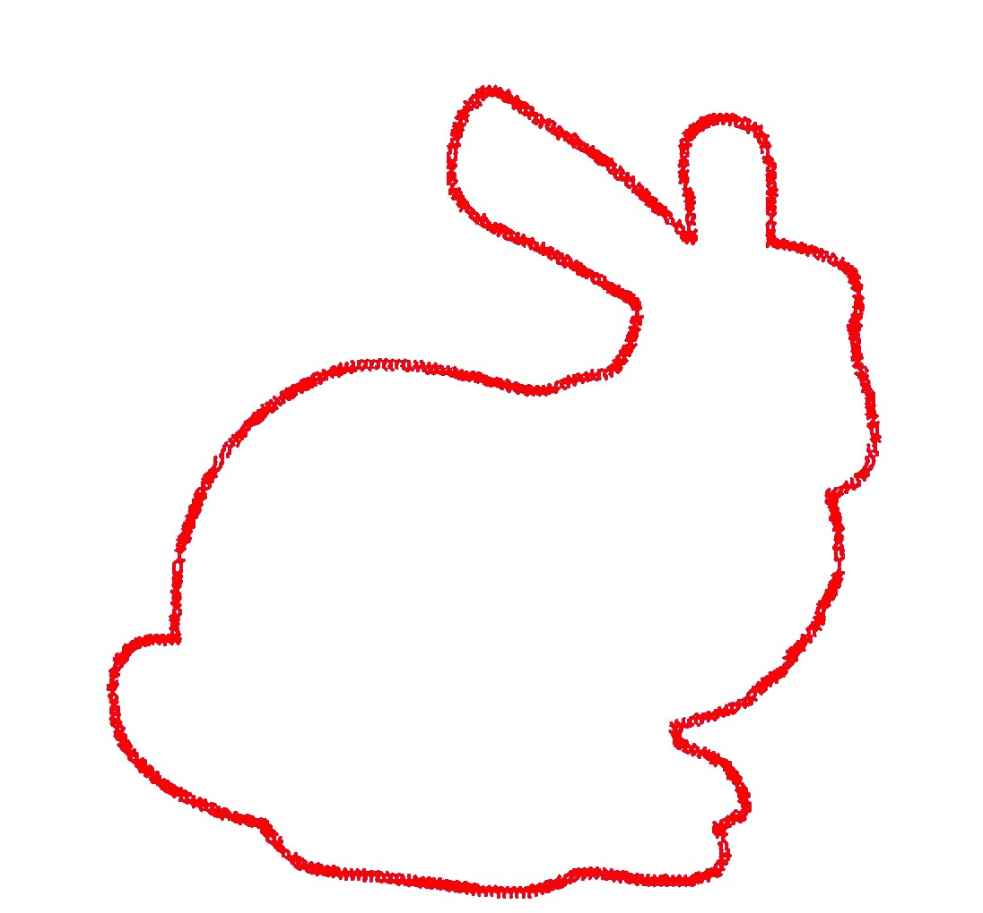
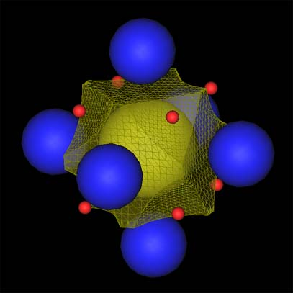
Basic Idea
Voronoi Diagram Research Center
Hanyang University, Seoul, Korea
Motivation Basic Algorithm Parallel Algorithm Results Conclusion

Slide 8
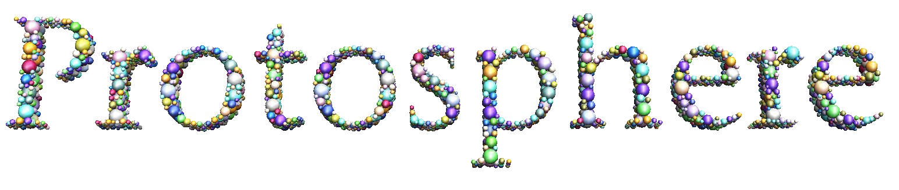
- Basic Algorithm
d
P
d
Motivation Basic Algorithm Parallel Algorithm Results Conclusion

Slide 9
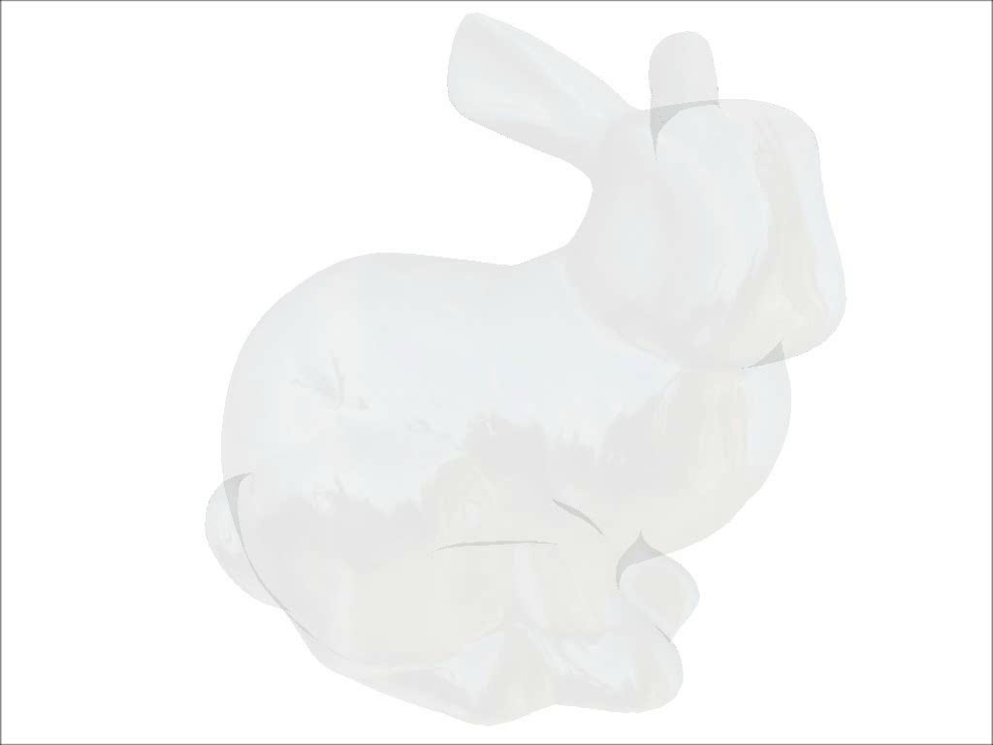
- Basic Algorithm
Motivation Basic Algorithm Parallel Algorithm Results Conclusion

Slide 10
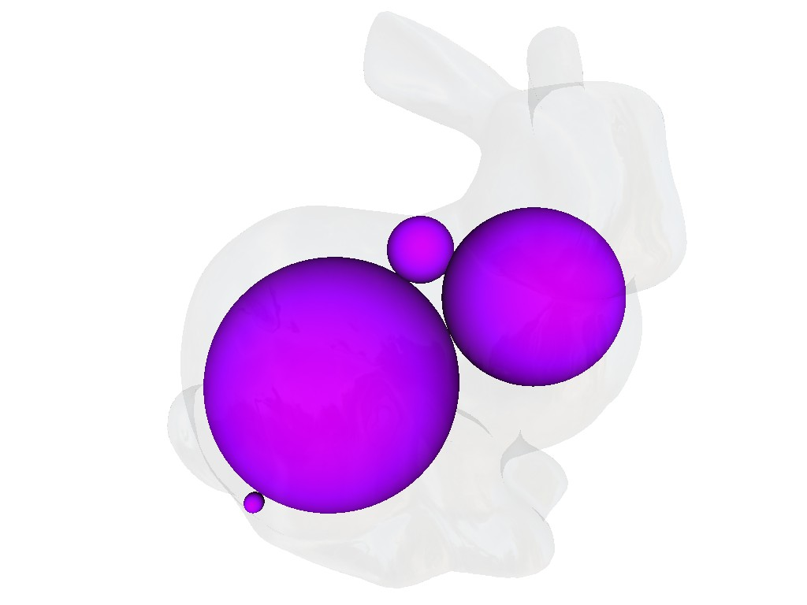
- Basic Algorithm
Motivation Basic Algorithm Parallel Algorithm Results Conclusion

Slide 11
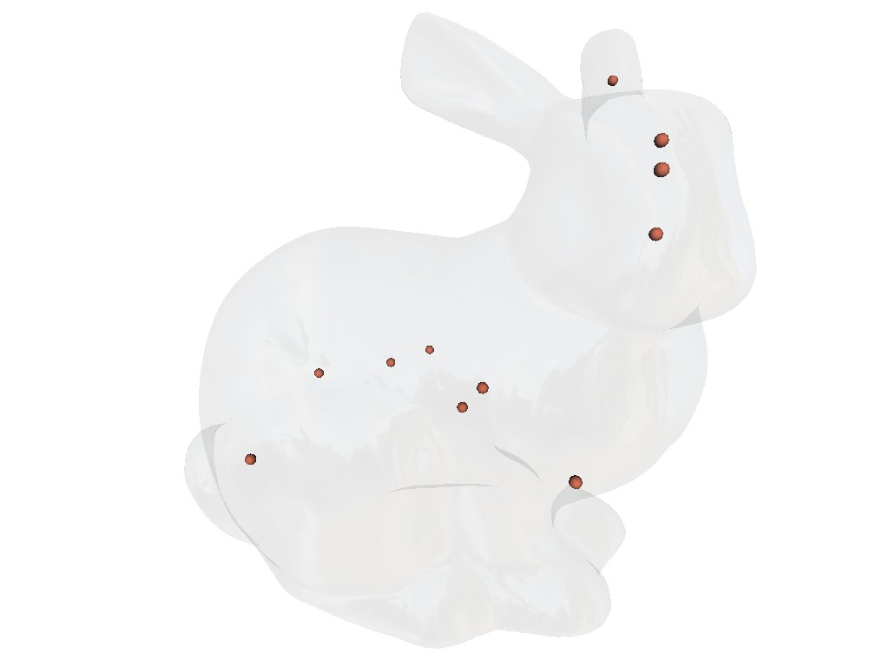
- Basic Algorithm
Motivation Basic Algorithm Parallel Algorithm Results Conclusion

Slide 12
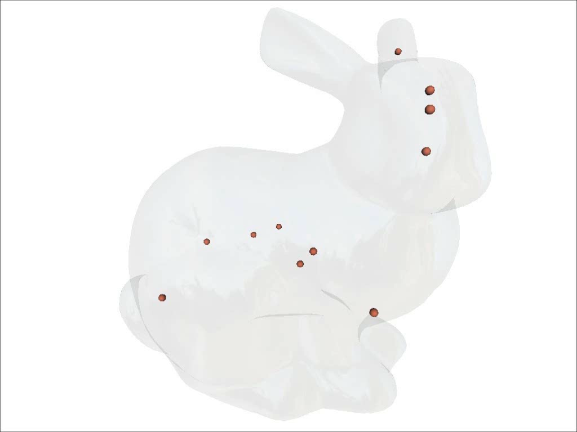
- Basic Algorithm
Motivation Basic Algorithm Parallel Algorithm Results Conclusion

Slide 13
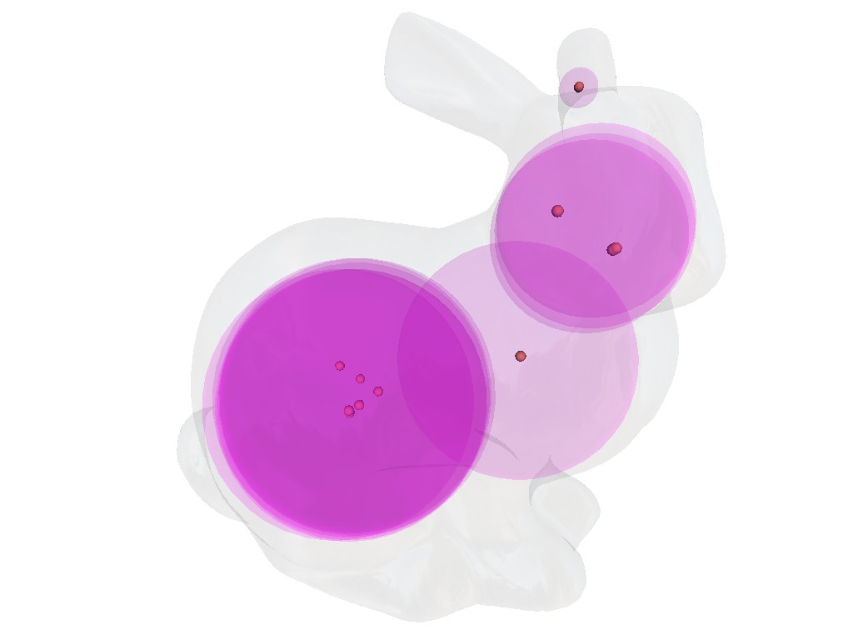
- Basic Algorithm
Motivation Basic Algorithm Parallel Algorithm Results Conclusion

Slide 14
Parallelization
Motivation Basic Algorithm Parallel Algorithm Results Conclusion

Slide 15
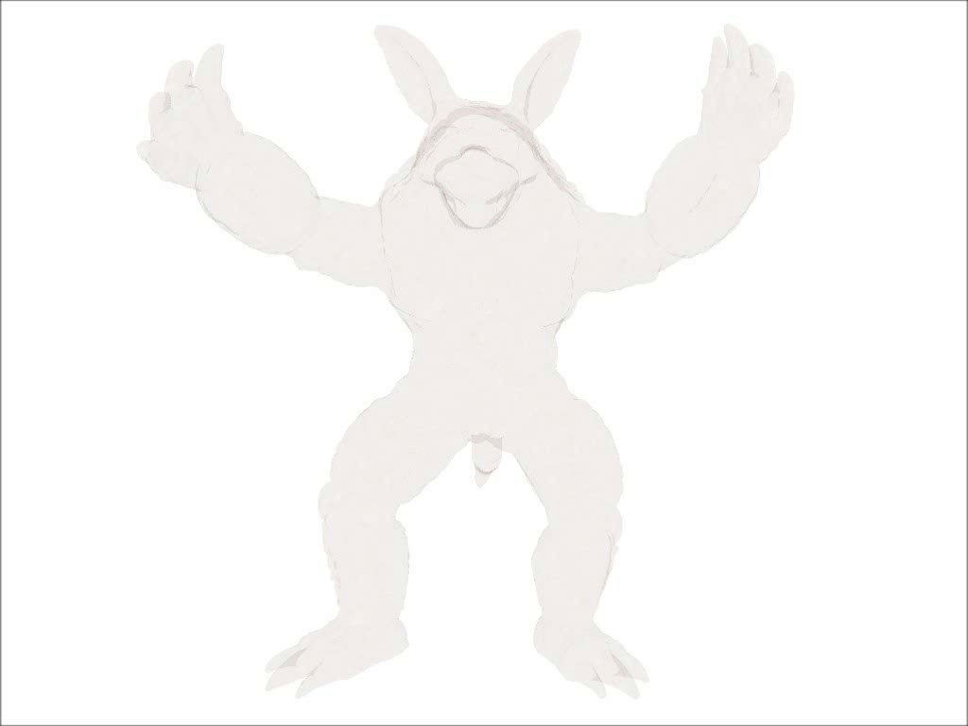
Parallel
Motivation Basic Algorithm Parallel Algorithm Results Conclusion

Slide 16
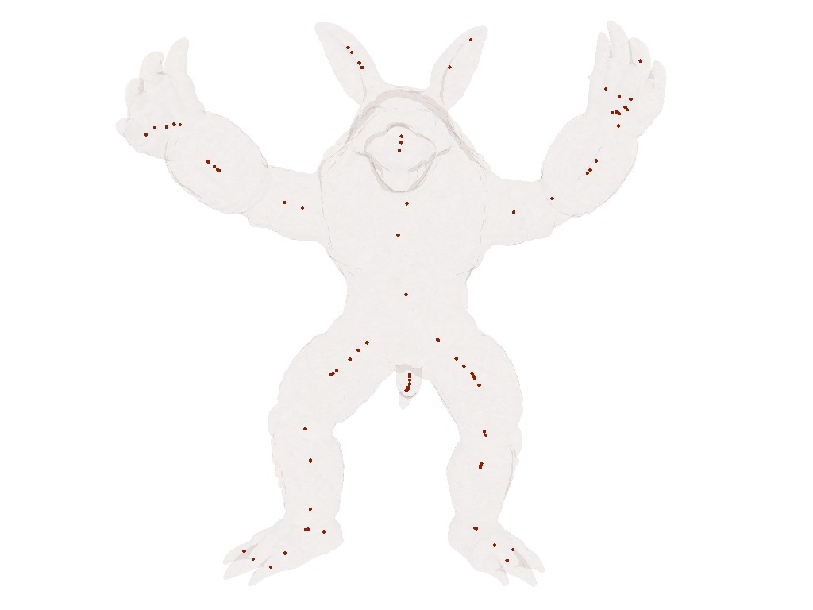
Parallel
Motivation Basic Algorithm Parallel Algorithm Results Conclusion

Slide 17
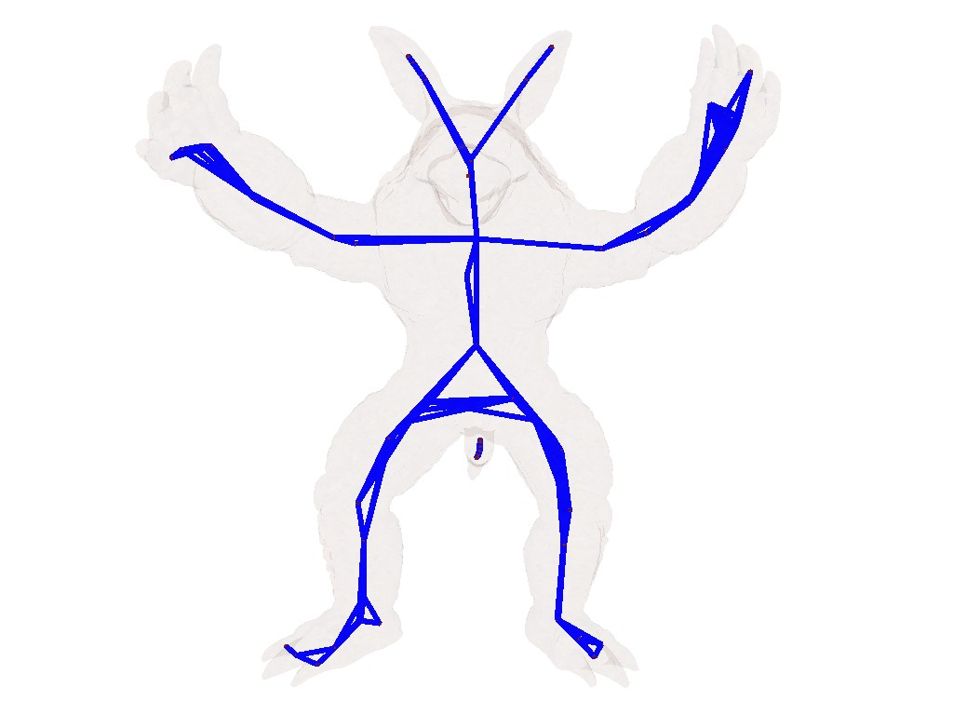
Parallel
Motivation Basic Algorithm Parallel Algorithm Results Conclusion

Slide 18
Parallel
Motivation Basic Algorithm Parallel Algorithm Results Conclusion

Slide 19
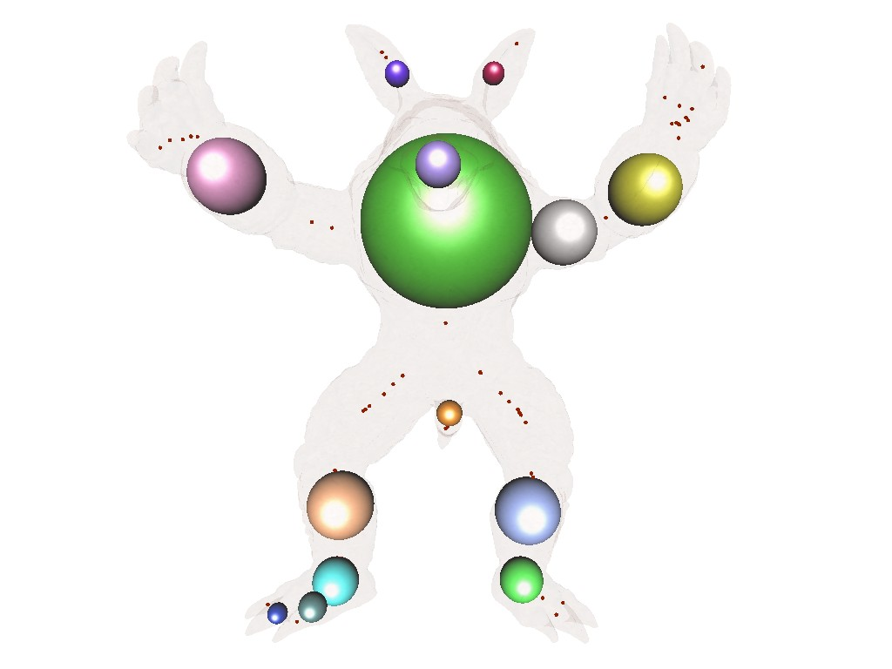
Parallel
Motivation Basic Algorithm Parallel Algorithm Results Conclusion

Slide 20
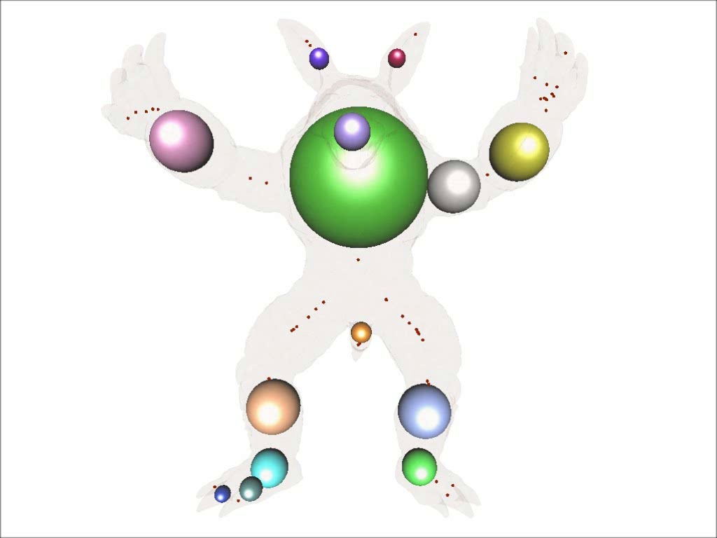
Parallel
Motivation Basic Algorithm Parallel Algorithm Results Conclusion

Slide 21
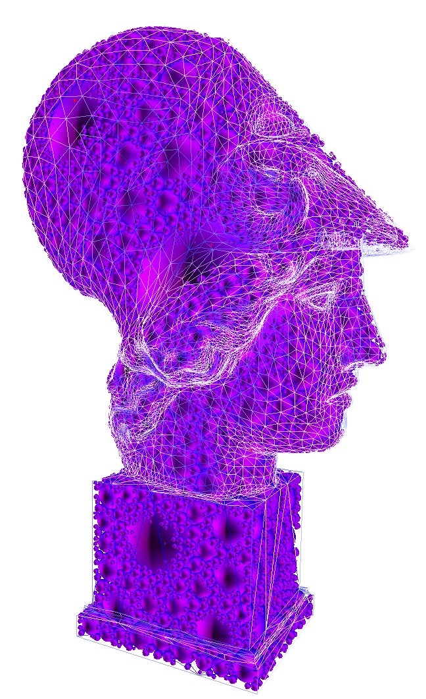
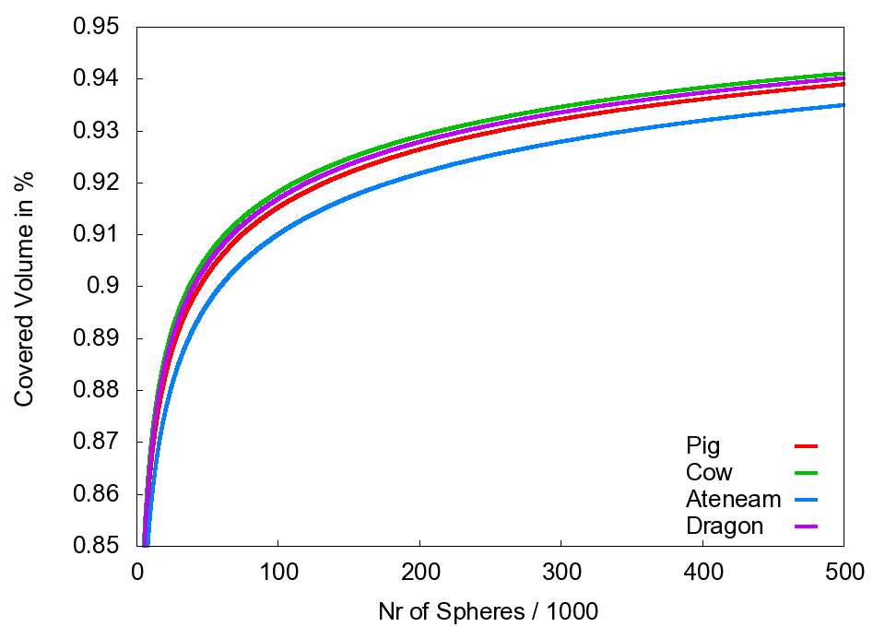
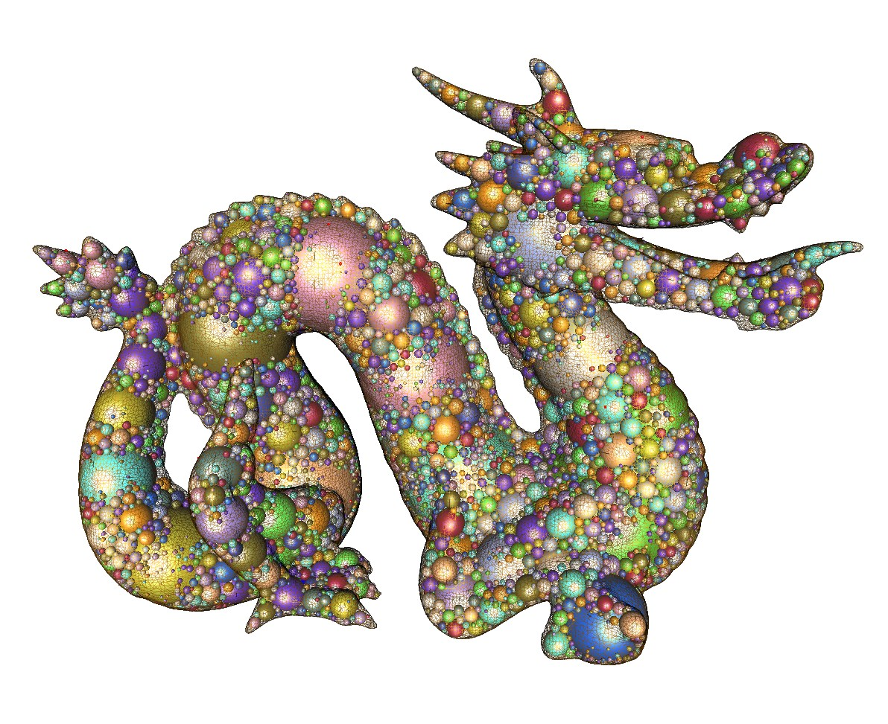
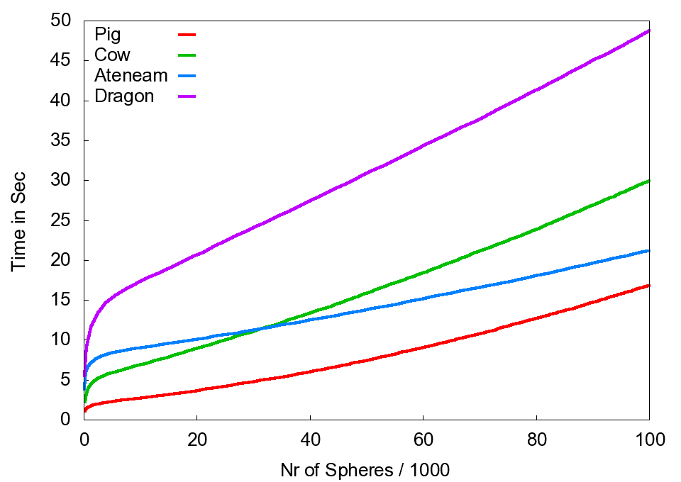
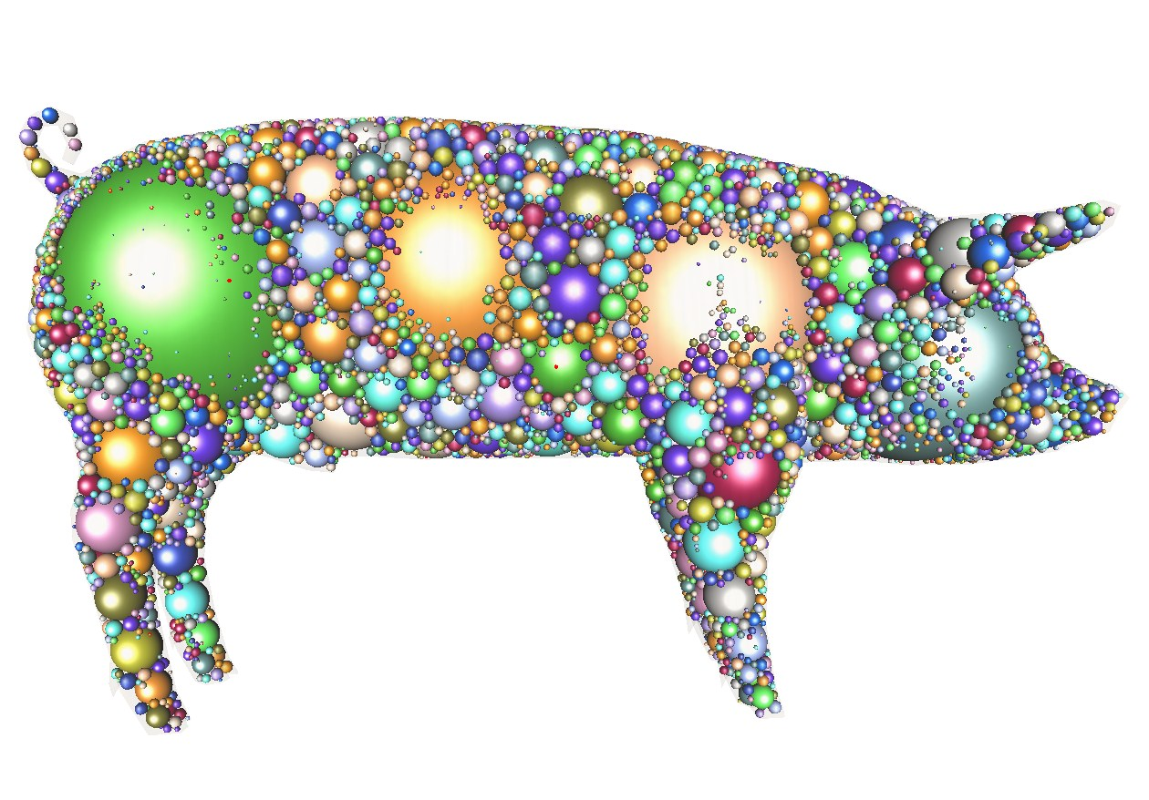
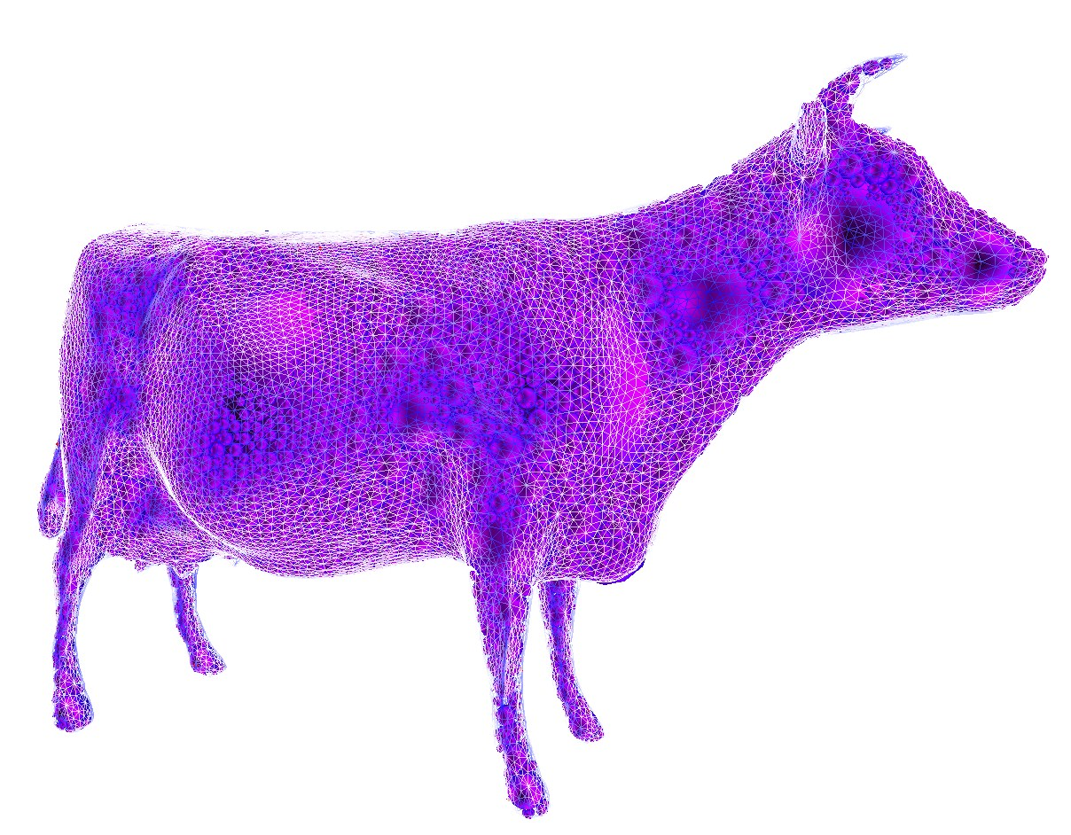
Results
Nvidia Geforce GTX 480
Motivation Basic Algorithm Parallel Algorithm Results Conclusion

Slide 22
Conclusions
New Sphere Packing Algorithm
Apollonian Sphere Packings for Arbitrary Objects
  Space filling
  > 90% with <100.000 spheres
Fast run time
  < 20 sec for 80k Spheres
Error <0.0001 compared to exact Voronoi nodes
Stable implementation on GPU
Approximation of Medial Axis
Supports all kinds of object representations
  Polygons, NURBS, CSG, Point Clouds, …
Easy generalization to higher dimensions
Motivation Basic Algorithm Parallel Algorithm Results Conclusion

Slide 23
Future Work
Blueprint for other generalized Voronoi diagram problems
Other filling objects
  Ellipsoids
Error estimation
Further improvement of run time
  Real-time approximation of medial axis
Replace greedy choice to solve other Sphere Packing problems
  Dynamic programming
Motivation Basic Algorithm Parallel Algorithm Results Conclusion

Slide 24

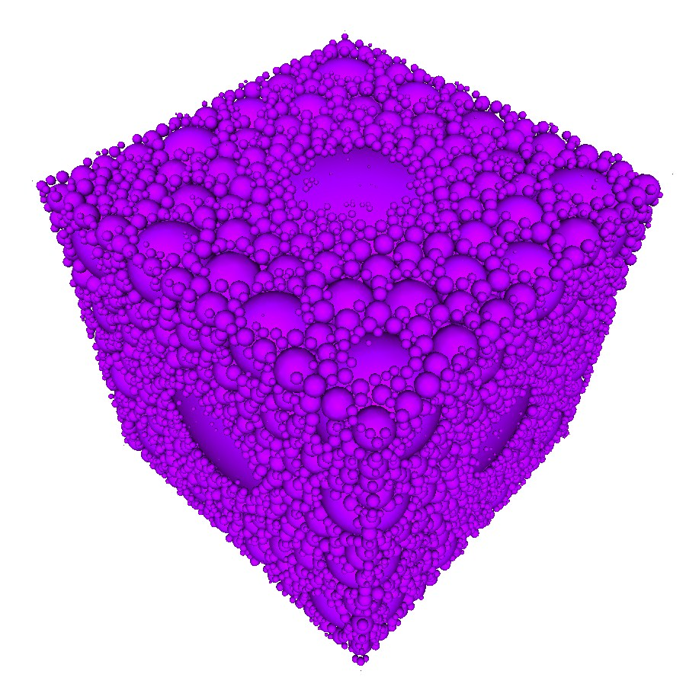
Acknowledgments
DFG grant ZA292/1-1
BMBF grant Avilus / 01 IM 08 001 U.

